Slide 1
Generic Tools
ROS & ZMQ Symbiosis
By Gil Kedar
RoBoX DiVision

Slide 2
O V E R V I E W
How Does ZMQ WORK
How To Implement
Motive and goals
Pamper Your Nodes
Generic Tools Design
Lets Get To Work

Slide 3
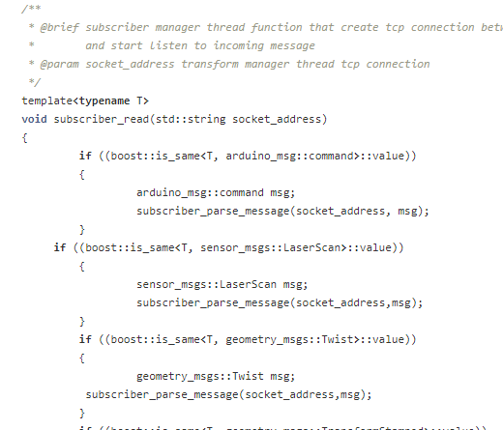
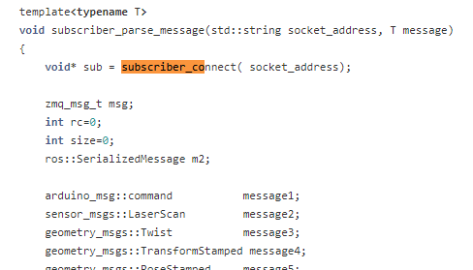
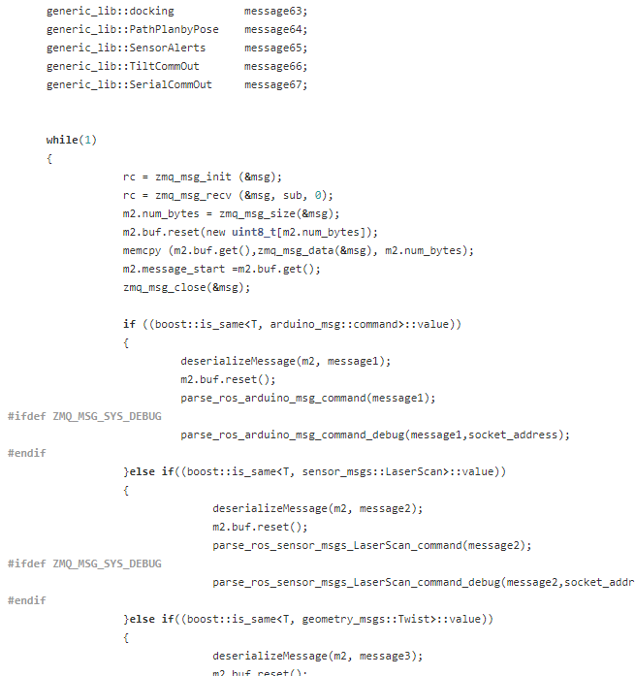
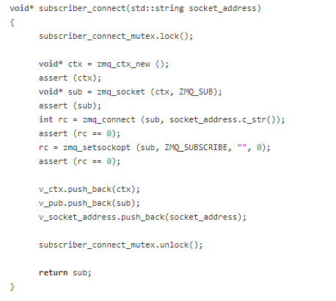
ZMQ Framework How does it work?!?
Framework in a nut shell
Every Node Inherits from zmq_subscriber,zmq_transform, zmq_config
The subscriber_read function calls parse_message, which creates a zmq_connection, listens to the sockets, deserializing the message, and sending it to the relevant virtual function
The virtual function is implemented again in {your_node}.cpp, and calls callback function/tf

Slide 4
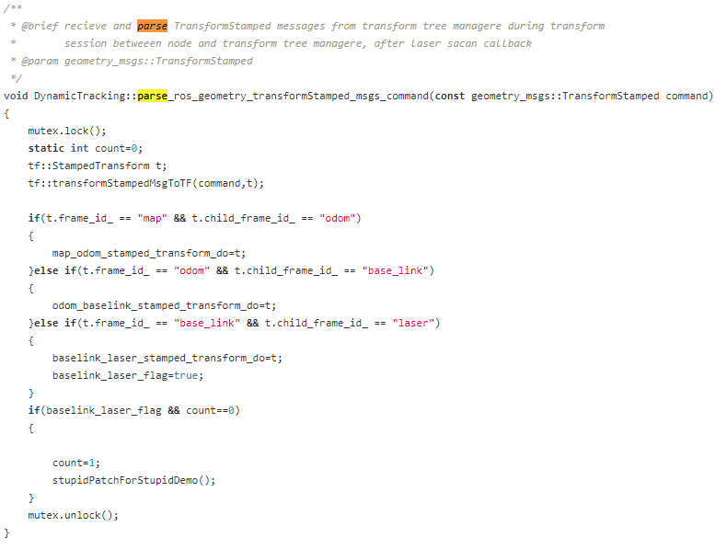
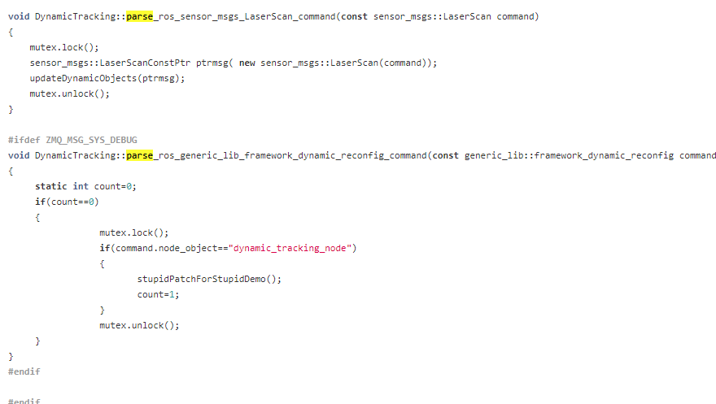

Slide 5
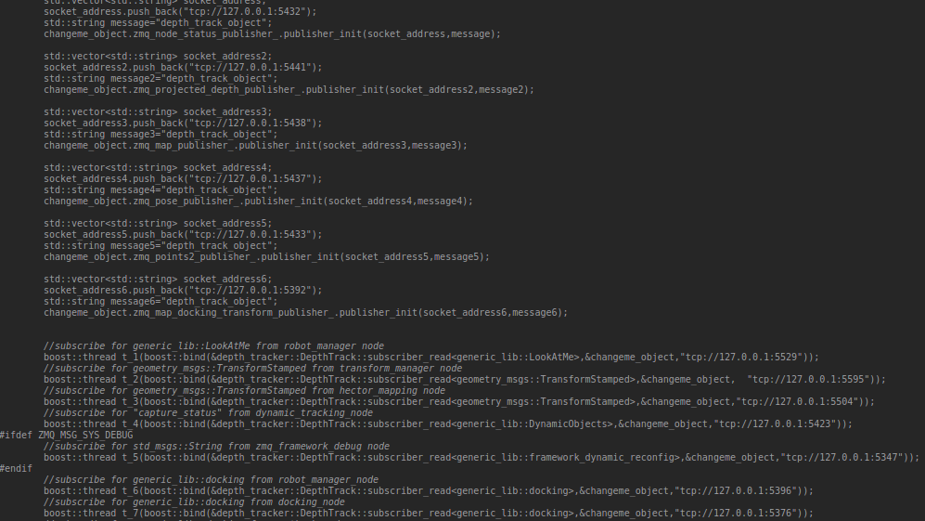
{node_name}_node.cpp example
Publisher - initializing zmq_multicast_publisher objects,
Subscribers - creating boost threads, for function ‘subscriber_read<message_type>’ in the zmq_subscriber.h file, with (node_object,socket address) as parameters

Slide 6
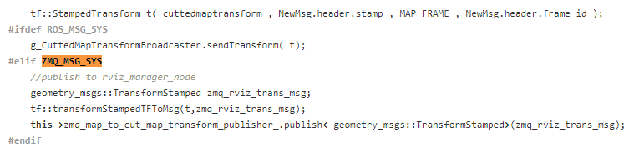
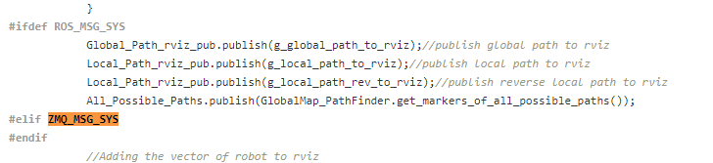

ZMQ Framework motive and goals
Current framework
New Code - > quality time with Oded
Code prone to errors
( 2 diffrenet inits - twice the errors possibilities)
Repetitive Code (parse_ros…)
Fuck those #ifdefs !
Same Mutex? New Mutex ?
New message type - > Add new code
Socket Addresses – which is what?
Debugging’s a bitch

Slide 7

GFW0MQ ( Any better ideas? Generic Framework 0Ver ZMQ Design
Generic Tools
GenericNode - every node inherits from this
GenericBase – every pub/sub inherits from this
Topic_to_zmq_port file – dynamic port allocation
GenericPublisher - template class < message_type>
GenericSubscriber – template class < object,message_type
GenericTfPub – In case you need to publish tf from your node
Health Monitor Manager
Syscommand Manager
BagRecorder Instance

Slide 8
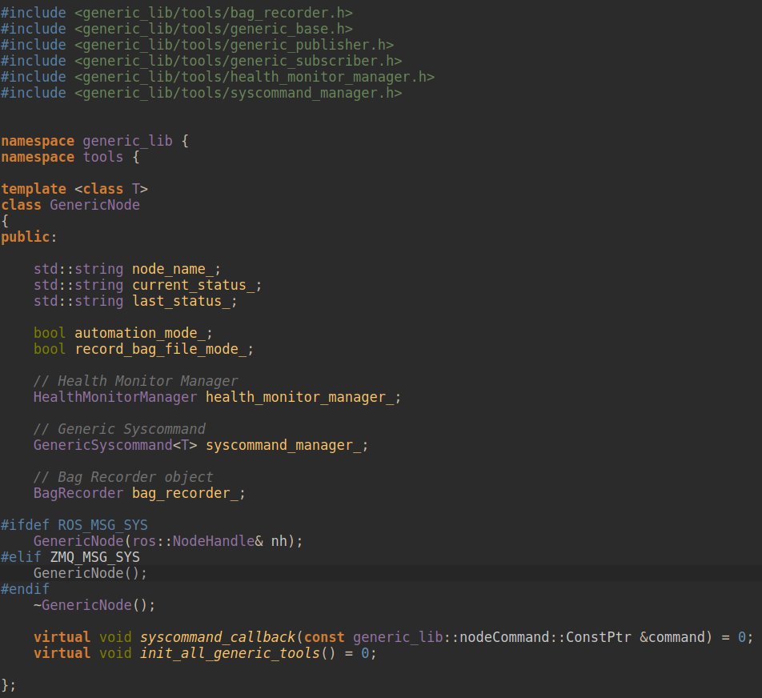
Generic tools
Generic Node
Has parameters that are relevant for all nodes
Receives ros::NodeHandler
Scalable for additions
Pure virtual functions

Slide 9
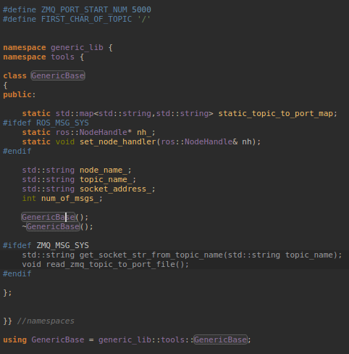
Generic tools
Generic Base
Once for every node, reads the zmq_port_to_topic file ( static ) into a static map
Sets a static nodeHandler(pointer) for the process
Holds the basic parameters for pubs/subs

Slide 10
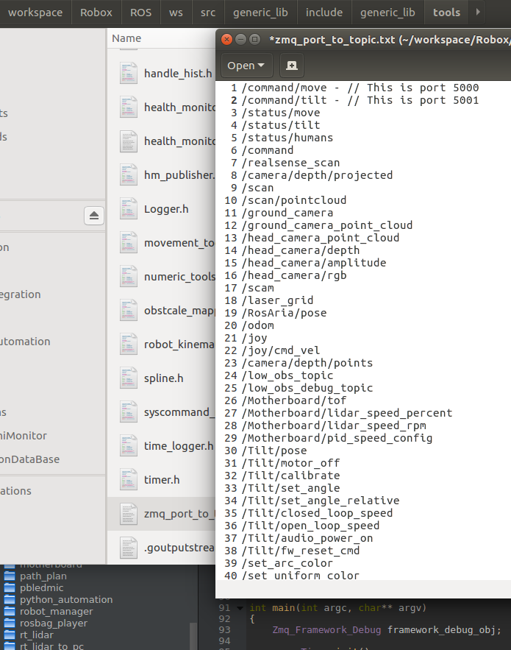
Generic tools
Topics to zmq Ports file
File is read once for every node, into a map
Std::map<std::string, std::string>
Topic name : tcp://127.0.0.1: PORT
When you add a new topic, you need to add it to the file as well. Otherwise node will not boot
Make sure topic name starts with ‘/’

Slide 11
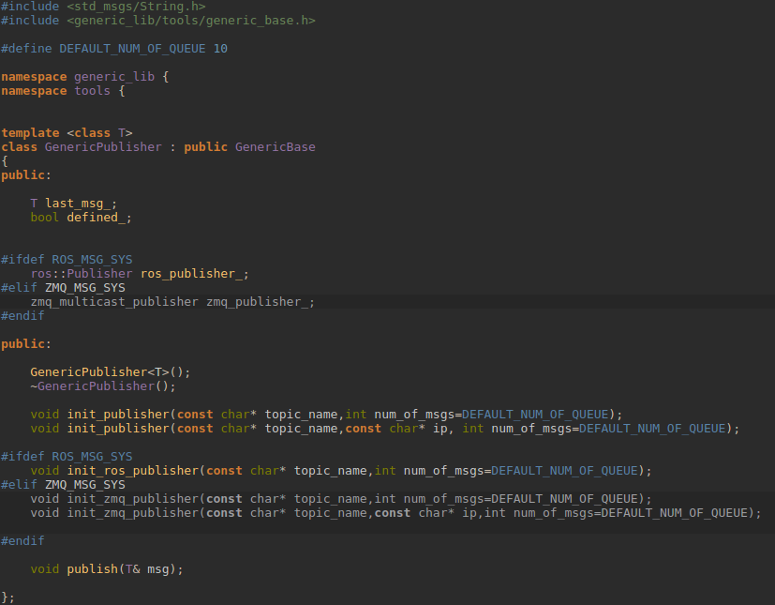
Generic tools
Generic Publisher
Init has function overloading
topic name
topic name, ip
Publisher can be defined in header - but only if initialized, it takes up resources
That’s why in the constructor, we will wrap the definition with {NODE}_DEBUG_MODE

Slide 12
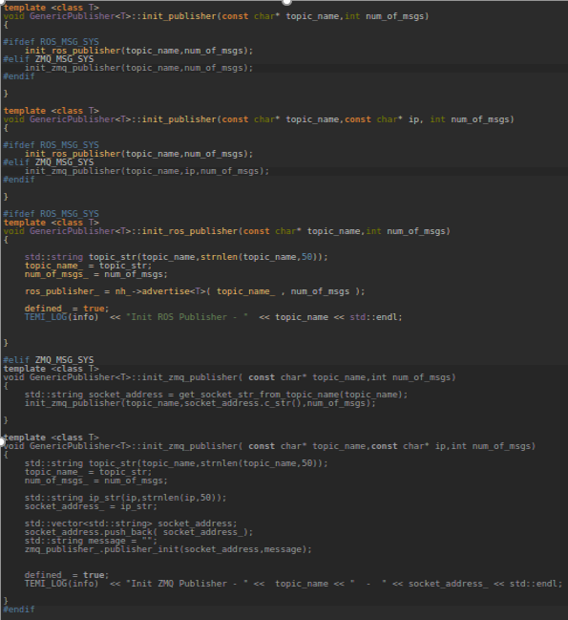
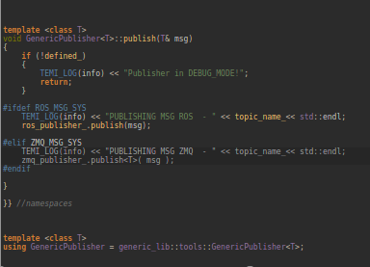
Generic tools
Generic Publisher Implementation
Notice the ‘const char’ – ONLY DEFINES
If ZMQ_PORT is not defined –read from file

Slide 13
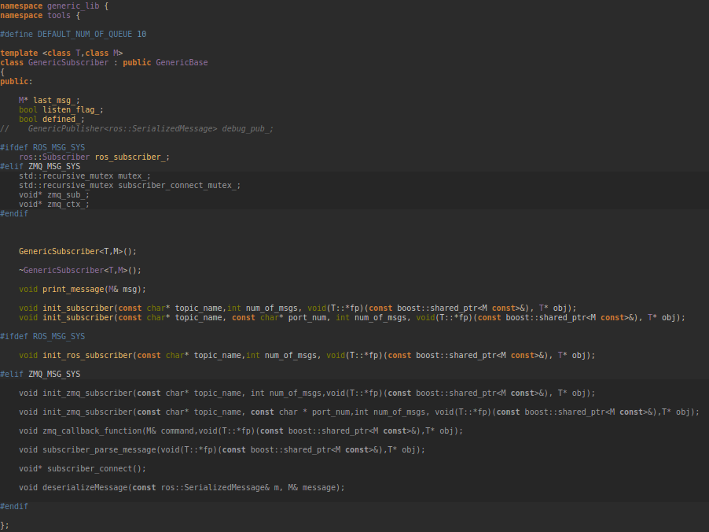
Generic tools
Generic SUBSCRIBER
ZMQ functions transferred to here
Init overloading
Templated function
T – Node Type (DynamicTracking)
M – Message Type

Slide 14
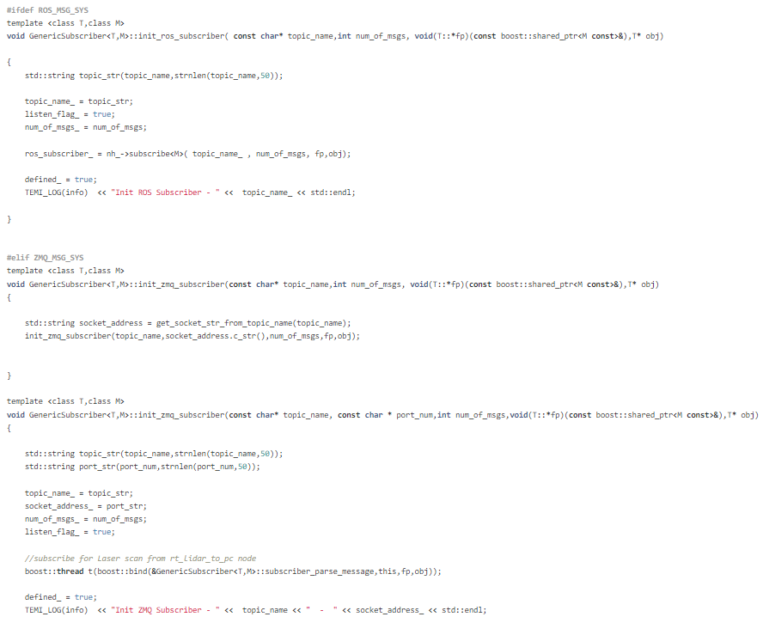
Generic tools
Generic SUBSCRIBER Implementation
ZMQ functions transferred to here
Init overloading
Templated function
T – Node Type (DynamicTracking)
M – Message Type

Slide 15
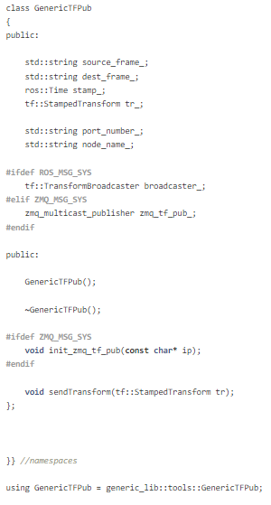
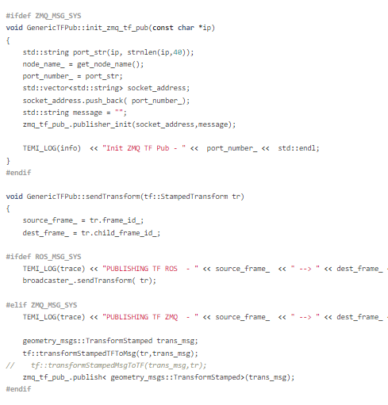
Generic tools
Generic TF Pub
Initialized only in ZMQ, in ros, just use the sendTransform function.

Slide 16
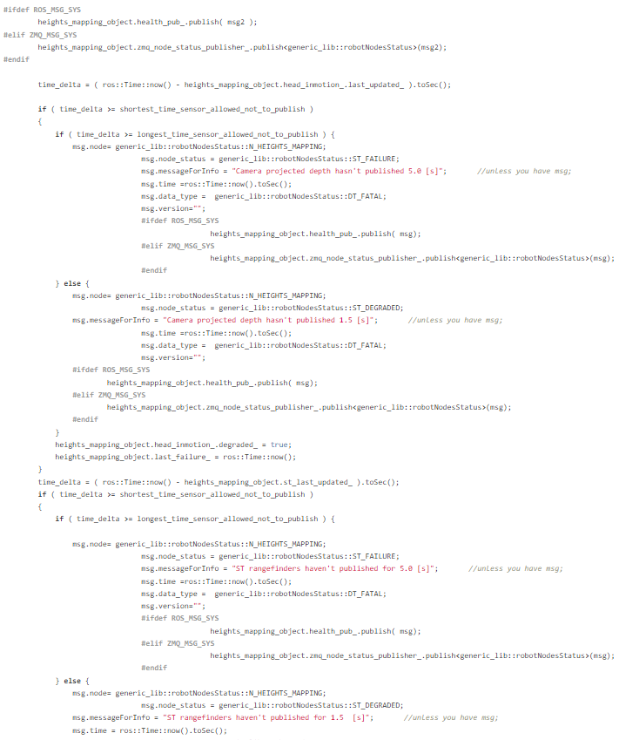
Generic Tool
Health Monitor manager
Create generic protocol for health monitor
Remove duplication of code
Centralize all health errors in one place
Prevent both TEMI_LOG and health publish

Slide 17
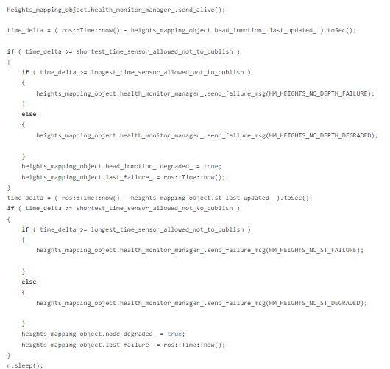
Generic Tool
Health Monitor manager
Much cleaner code
All errors in define
Easy to manage error types ( failure, warning, info..)

Slide 18
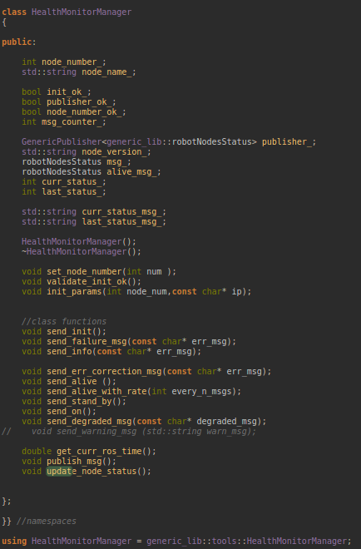
Generic Tool
Health Monitor manager
Scalable and simple API
Easy to manage nodes statuses

Slide 19
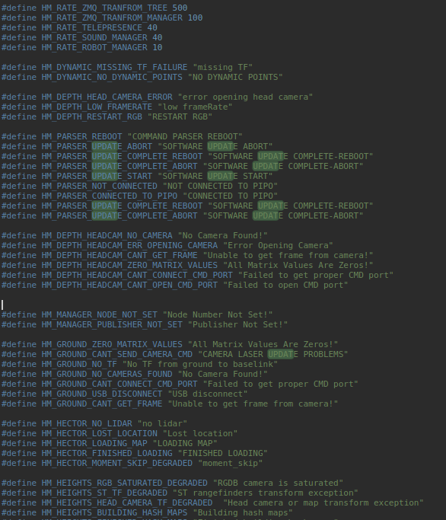
Generic Tool
Health Monitor manager
All Possible errors
Control nodes health monitor update rate easily
Located in health_monitor_manager.h

Slide 20
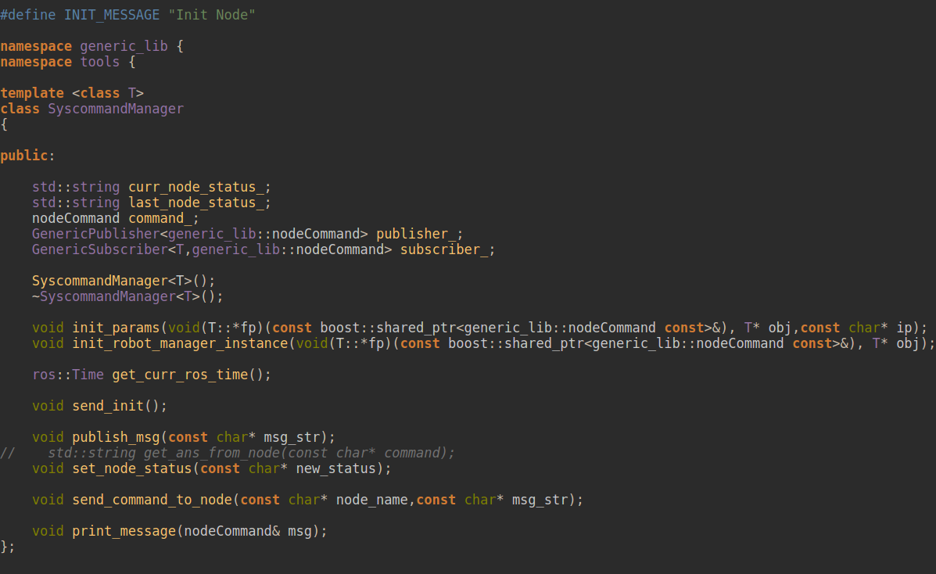
Generic Tool
Syscommand Manager
Allow easy and generic communication between nodes
Every node is connected to robot manager, listening to commands
Centralized all possible commands in one place
Can send only const char* (defines)

Slide 21
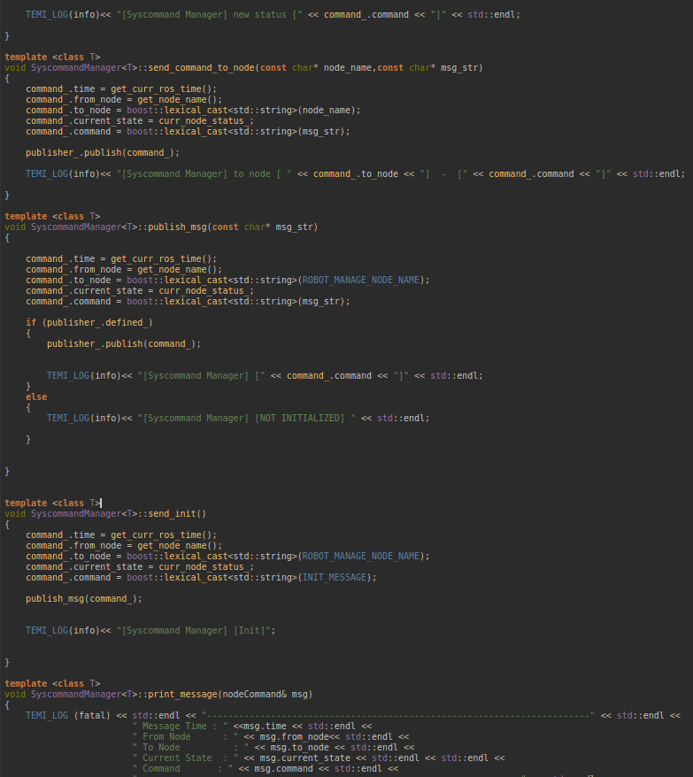
Generic Tool
Syscommand Manager
Created new scalable message type to extend data transfer ability
Generic_lib::nodeCommand

Slide 22
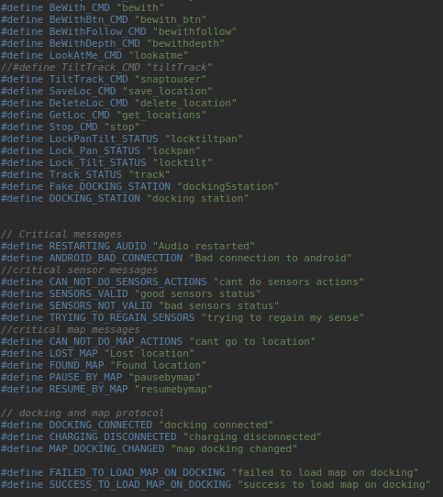
Generic Tool
Syscommand Manager
All Commands should be in generic_lib/defines.h

Slide 23
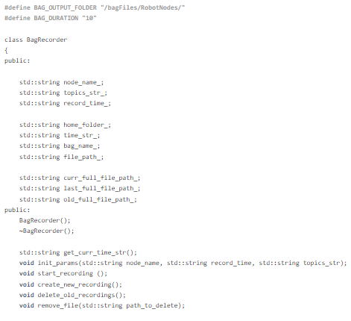
Generic Tool
Bag Recorder
Ros Only ( for obvious reasons )
Only for debugging
Constantly records bag files
To catch spontaneous bugs “on film”
Every node should decide on the relevant topics to record
Files automatically saved and deleted in BAG_OUTPUT_FOLDER path

Slide 24
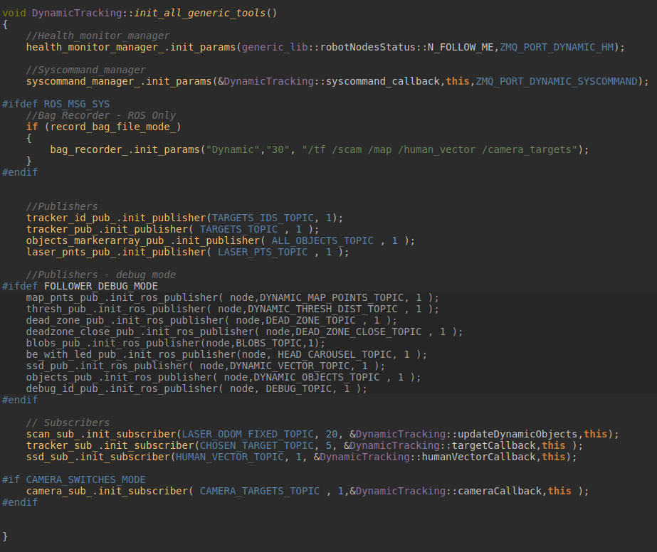
Generic Tool
SUMMARy
This is how the virtual function ‘init_all_generic_tools’ should look like on all nodes
Don’t forget to define {NODE_NAME}_DEBUG_MODE to minimize resources in real_time

Slide 25
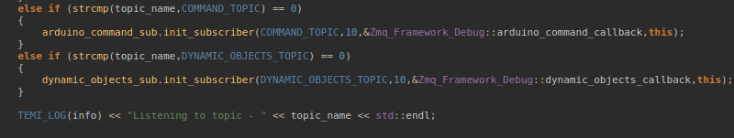
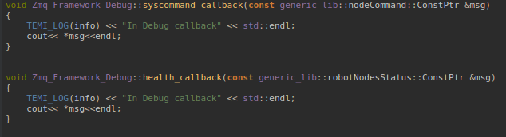
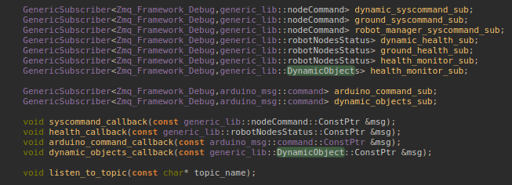
Generic Tool
How to test and debug
Add a GenericSubscriber for your topic in header
Add include to your message type if necessary
Add a callback function in header and cpp
Add else if code chunk in ‘listen_to_topic’ func
Hopefully will become more generic soon!
Zmq-echo /syscommand
(Don’t forget to add zmq-echo to bash rc)
Otherwise – rosrun zmq_framework_debug zmq_framework_debug_node /syscommand

Slide 26
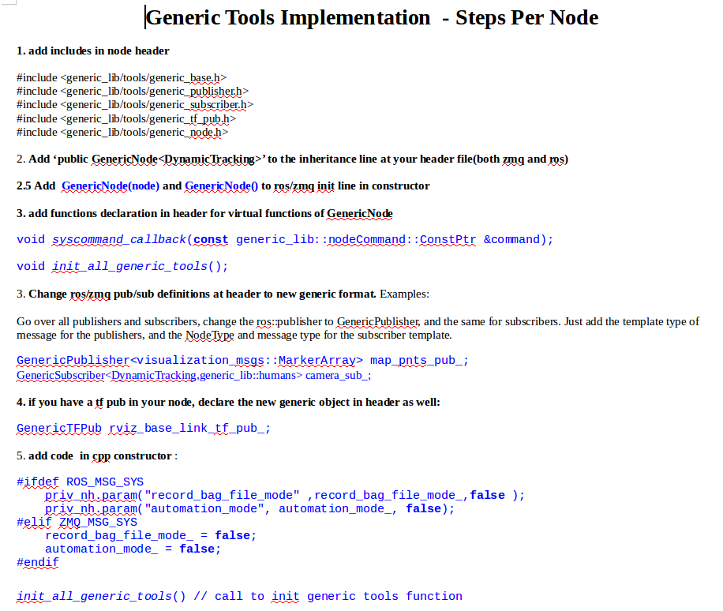
Generic Tool
HOW TO IMPlement?!?
Switch to brnch “genericTools_implementation_on_nodes’
Create a new branch with your name:
Git checkout –b ‘genericTools_impl.._gil2’
Go to GenericTools folder in Algorithms
Open Generic Tools Implementations file
Follow instruction on documentation
test and debug your new nodes
Merge back into main branch

Slide 27
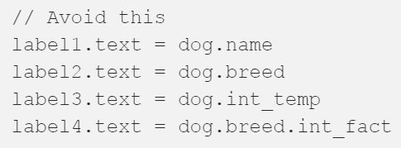
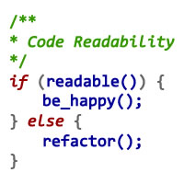
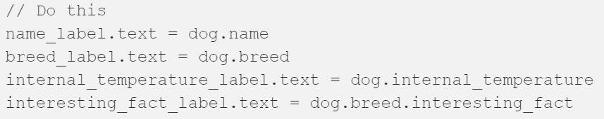
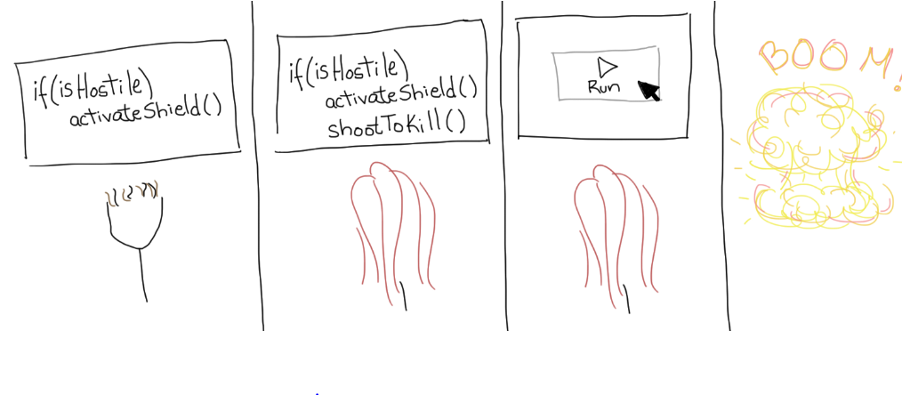
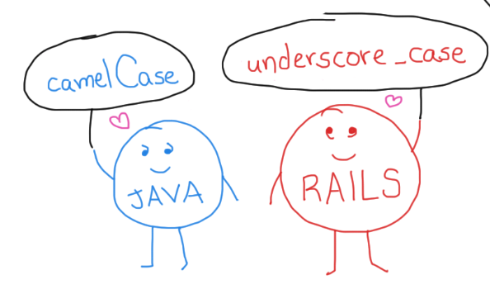
Pamper your nodes while your at it
Clean code guidelines
No magic numbers, No magic strings. Defines
Short functions – avoid deep nesting
Meaningful Parameter Names
Follow the conventions
Protect your parameters from the unknown
Use mutexes for shared resources
( global,static,files, etc…)
Share your thoughts and flow – write comments
Reduce code repetition
Ctrl+I that motherfucker
click here for more examples
And Here for more details

Slide 28

Lets get to work !
Nodes distribution
Roee – Heights,rt_lidar_to_pc,
Gil1 – depth_track, hector_mapping
Itamar – motherboard, pbledmic,rt_lidar,tilt
Oded – command_parser, zmq_transform_manage,zmq_tree
Aviad – ground_camera_pub,health_monitor
Dor – adb_monitor,aviads,telepresence,aviads health_monitor
Yarden – path_plan,
Assaf – Local obs map, dynamic_tracking?
Tal – robot_manager
Shir –aviads ground, joy, xboxJoy, monitor_wd

